Slide 1
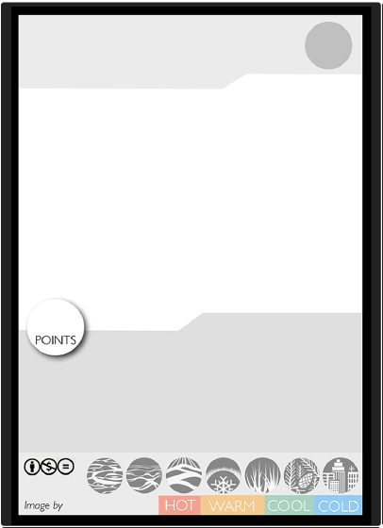
PLAY:
Special Structure:
Card by

Slide 2
PLAY:
Special Structure:
Card by

