Slide 1
This is an energy system
How does energy transform?

Slide 2
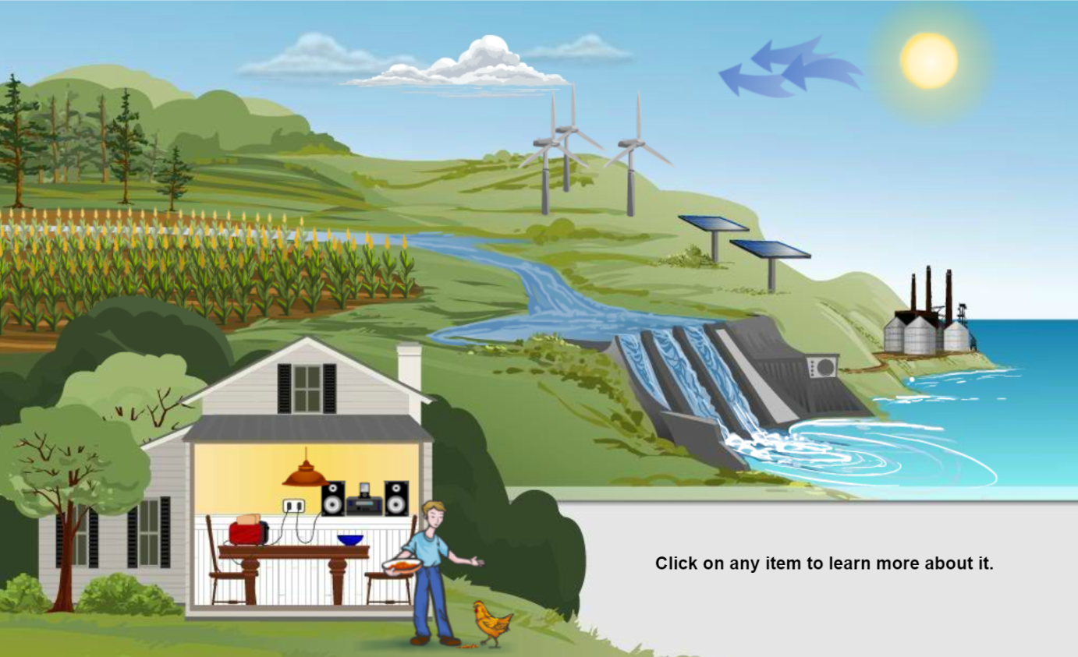
1. Which object converts sunlight into sugars? 2. Which object converts wind power to electricity? 3. Which object converts light to electricity? 4. Which object converts electricity to sound?
Station 1: Intro
Read the cards to answer these questions!

Slide 3
Station 2: Energy Paths
5. Energy FLOWS through this system. Arrange the cards on your desk. to demonstrate how energy flows from the sun to the person like this. (Write your answer on your paper)
6. Arrange the cards to show 4 different energy path to power a toaster. Use chalk to draw arrows on your desk to show the energy flowing. (Record your answers on your handout and leave the cards set up on desks)
7. Where does each path begin?
8. What would life on Earth be without the Sun
Checkpoint! Raise your hand your teacher will check your toaster paths and give you the next 2 cards.
Sun
______
______
Person

Slide 4
Use the cards to explain how item converts the energy into a new form. (Don’t forget to use the info on the cards and the path can’t have the toaster in it.
Station 3: Conversion
9. and 10. Fill in the chart on your handout
11. Where in these cards (or in real life) do the following energy conversions occur?
Chemical to thermal to electrical current?
Gravitational potential to kinetic to electrical current?

Slide 5
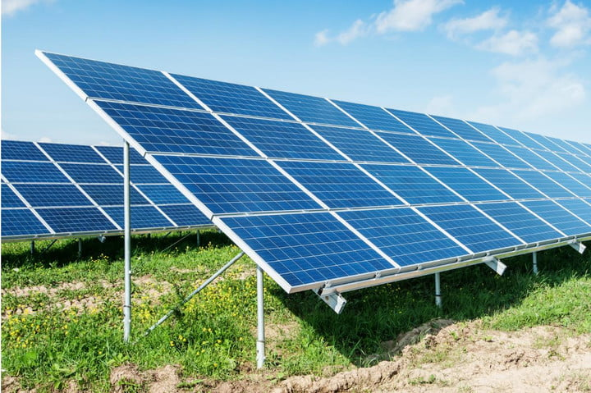
Describe: Four examples of renewable resources are on your cards. These resources are produced all the time, so they will not run out. Read the cards on each energy source, and then explain how each is produced in your own words.
Station 4: Renewable

Slide 6
Printing instructions
Stations 1-2 go on 1 page
Stations 3-4 go on 1 page.
Should change the card design color so they look different
Items cards are 6 to a page which should be 2 pages

Slide 7
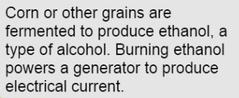
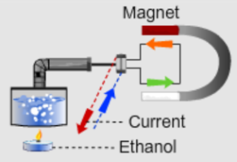
Ethanol Plant

Slide 8
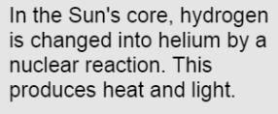
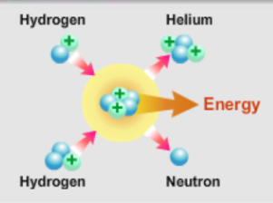
The Sun

Slide 9
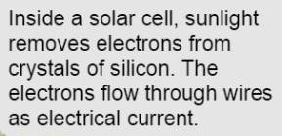
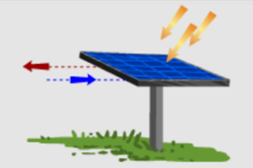
Solar Panel

Slide 10
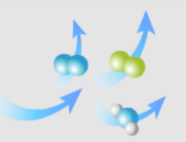
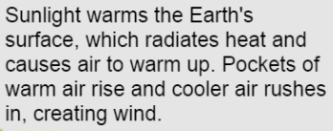
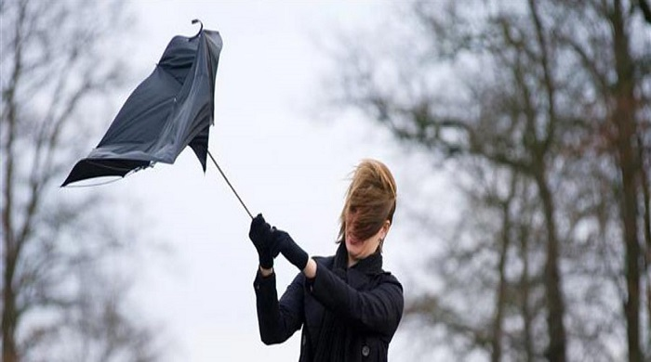
Wind

Slide 11
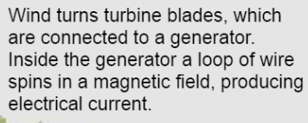
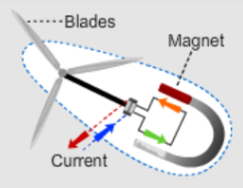
Wind Turbine

Slide 12
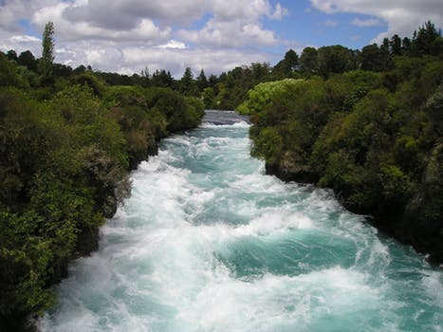
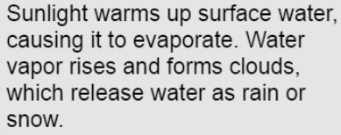
Moving Water

Slide 13
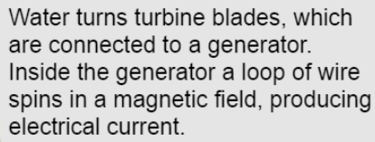
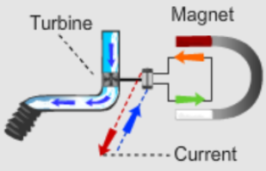
Hydroelectric Dam

Slide 14
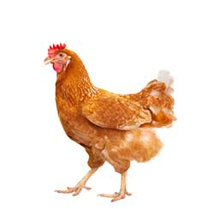
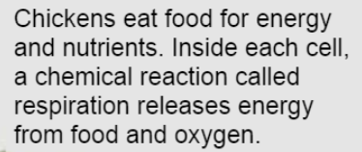
Chicken

Slide 15
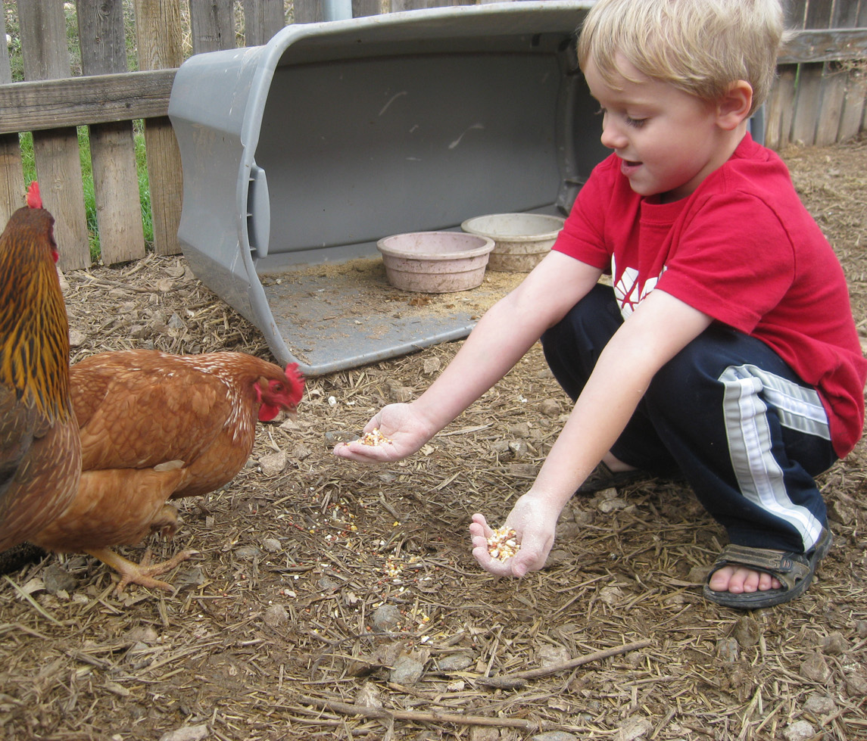
Person

Slide 16
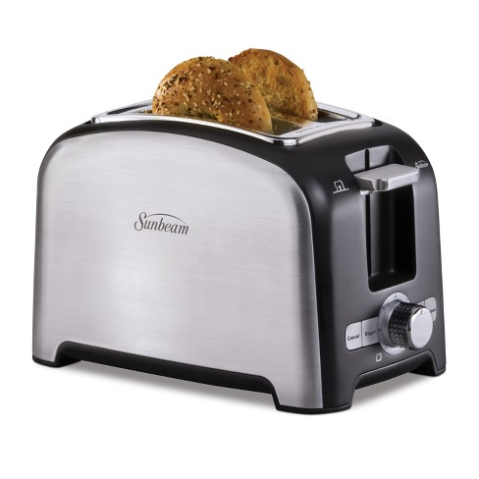
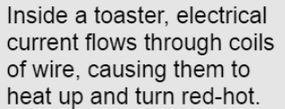
Toaster

Slide 17
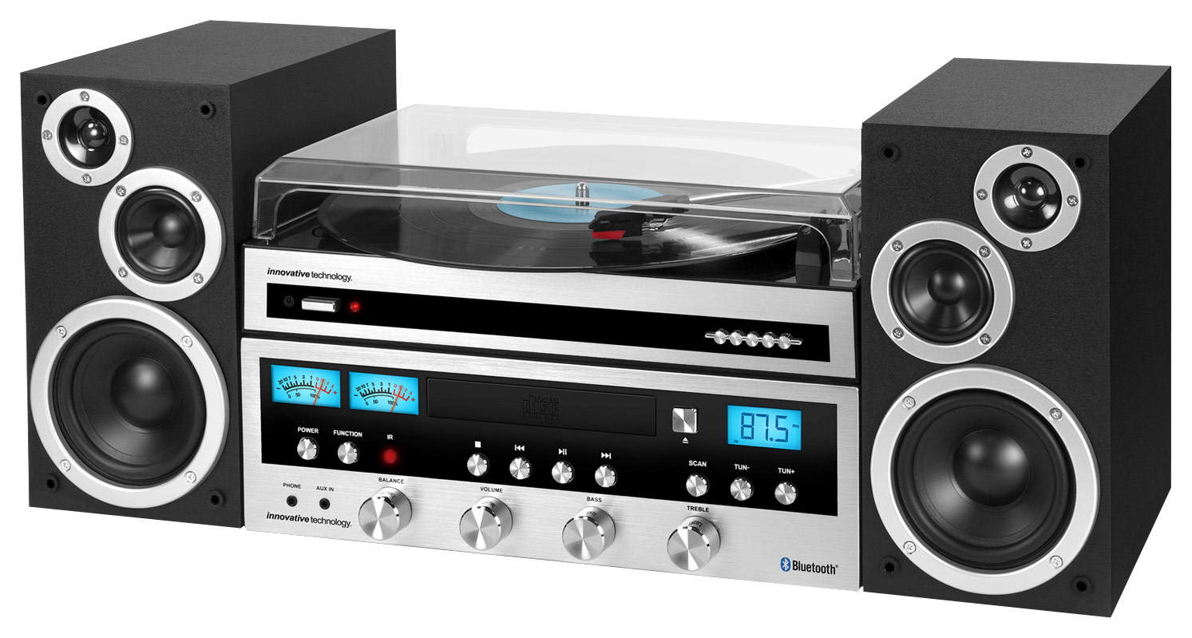
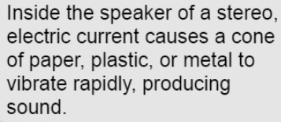
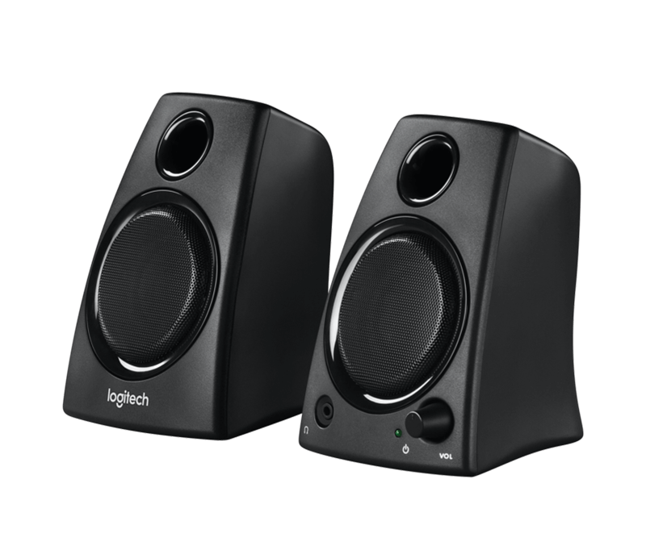
Stereo Speakers

Slide 18
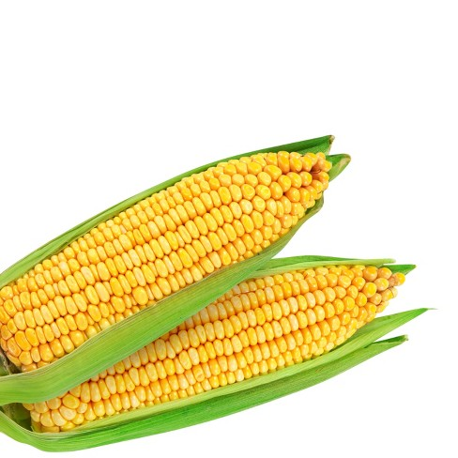
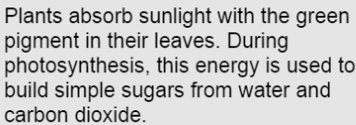
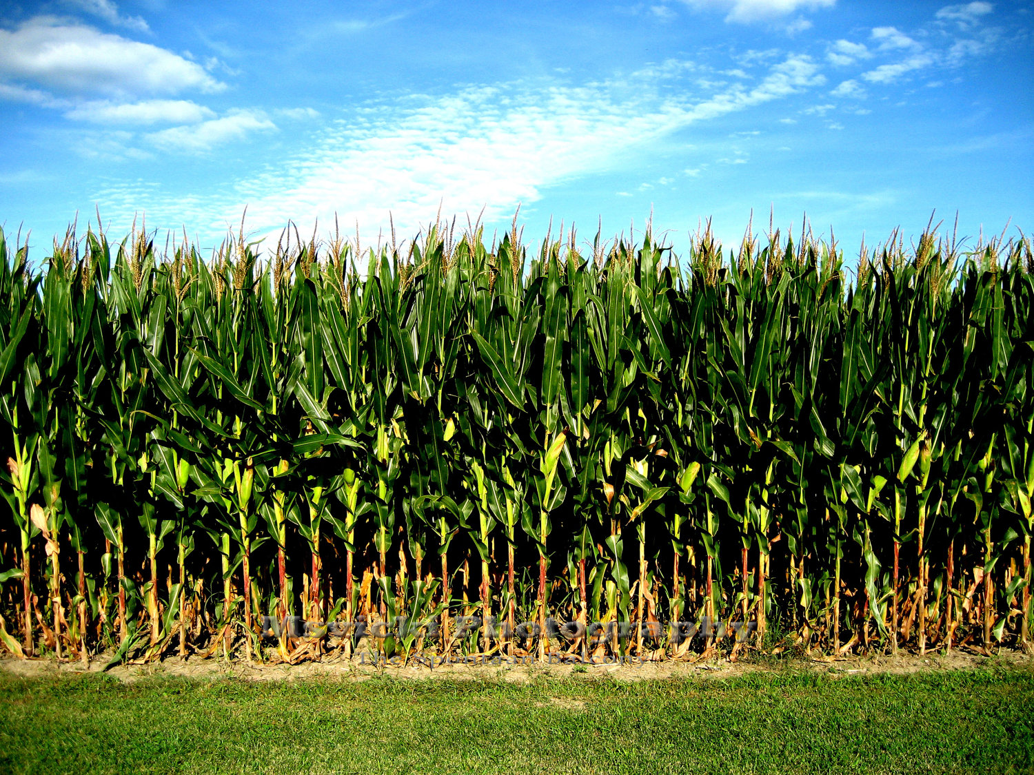
Corn

Slide 19
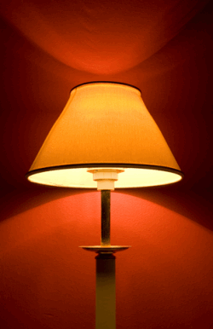
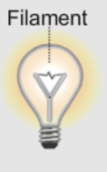
Lamp Light

