Slide 1
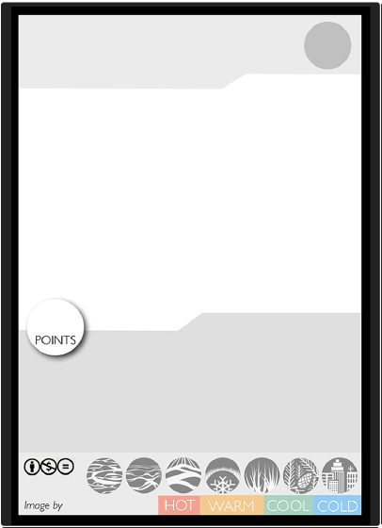
Card by

Slide 2
Card by

